Slide 1

DEPARTMENT OF COMPUTER SCIENCE & ENGINEERING
SCHOOL OF COMPUTING
1156CS701- MAJOR PROJECT
INTERNSHIP THROUGH ABROAD
WINTER SEMESTER(23-24)
REVIEW - II
“GMAI - Augmented Mouse Using Hand Gesture Recognition by Artificial Intelligence”
SUPERVISED BY
Dr. Sibi Prabha
PRESENTED BY
1. M.BANTI(VTU18232)(20UECS0606)

Slide 2
INDUSTRY DETAILS
Industry Name/Institute Name: UNIKL
Duration of Internship (From Date – To Date) Oct-23/2023- Mar 23/2024
Duration of Internship in Months :6 Months
4. Industry Guide Name :Ts. Suguneswari Raja Gopal
Industry Guide Mobile No : +60 122087077
Industry Guide Mail ID :
6. Industry Address : Jalan Sultan, Qill city Mall opp,UNIKL, Kuala Lumper, Malaysia
7. Project Completion Status as of now: In-Progress

Slide 3
AGENDA
ABSTRACT
OBJECTIVE
INTRODUCTION
LITERATURE REVIEW (SOFT COPY OF PAPERS TO BE LINKED AS HYPERLINK)
DESIGN AND METHODOLOGIES
IMPLEMENTATION
TESTING
INPUT AND OUTPUT
INCLUDE DEMO VIDEO-1 (Till REVEW-1)
INCLUDE DEMO VIDEO-2(Complete Implementation of Project)
CONCLUSION
WEB REFERENCES LINK(TILL REVIEW DATE ALL LINKS TO BE INCLUDED DAY WISE)
INCLUDE YOUR 2 PHOTOS OF YOUR INDUSTRY WORKING ENVIRONMENT
PLAGIARISM REPORT OF PPT
REFERENCES

Slide 4
ABSTRACT
The computer mouse exemplifies significant progress in Human-Computer Interaction (HCI). While today's wireless and Bluetooth mice still rely on peripherals such as batteries and connection cards, they are not entirely free from peripherals. The proposed AI virtual mouse system tackles these challenges by capturing hand movements through an external or digital camera, enhancing accuracy with voice assistants and hand-point detection via object recognition. Built on a foundation of machine learning techniques, this system enables computer operation, navigation, and actions like left- and right-clicking through digital hand motions, eliminating the need for a physical mouse.
Employing machine learning for hand identification and Python modules for voice assistance, this approach minimizes human involvement and the use of computer-controlled equipment. In the fight against the spread of COVID-19, it streamlines essential mouse functions, including brightness, volume control, and the management of noise variations. Overall, the GMAI virtual mouse system represents a promising direction in HCI research, offering a more intuitive and hygienic alternative to traditional input devices while leveraging the power of machine learning and AI technologies.

Slide 5
OBJECTIVES
Aim of the Project:
The goal of the Augmented mouse utilizing hand recognition project is to enable users to control their computer cursor using hand movements, with voice assistant and using voice commands making computer use more instinctive and natural for users. The goal of the project is to create a user-friendly interface that makes computer use simpler and more pleasant for users while also developing an accurate and dependable hand recognition algorithm. To develop a virtual mouse using hand recognition and Voice assistant is to create a more natural and intuitive way for users to interact with computers, by enabling them to control their computer cursor using hand gestures.

Slide 6
INTRODUCTION
Over the past few years, the growing availability of software packages enabling specific processing and facilitating seamless connections between computers and computing devices has sparked heightened interest in the development of human-computer interaction systems. This surge has prompted students, engineers, and scientists to focus their efforts on crafting user interfaces that are natural, intuitive, and responsive. This AI-powered digital mouse device integrates voice assistant capabilities and hand gestures, enabling users to perform mouse-like actions on a computer with innovative and intuitive control methods.
The AI virtual mouse system detects the movement of a user's fingertip to conduct mouse cursor actions like clicking, scrolling, pointing, and perform brightness and volume control, either via a web camera, lens or a in-built camera. Voice assistant can Capable of responding to user inquiries by detecting specific keywords and filtering out background noise, a voice assistant serves as a digital helper that utilizes advanced technology, human voice synthesis, and algorithms to attentively process spoken commands, providing relevant information or executing designated tasks..

Slide 7
Hand gesture movements have replaced the traditional mouse function of moving a visual object in the designed system, aiming for cost-effectiveness by utilizing inexpensive input devices such as a webcam to capture hand movements.
To manipulate materials, the system employs preset command-based movements. This project proposes an effective hand gesture and voice assisitant segmentation technique based on pre-processing, background subtraction, and edge detection approaches. Hand movements have taken over the role of moving visual objects, eliminating the need for traditional mouse functions. Engineered for affordability, the system utilizes budget-friendly input devices such as a webcam to capture and interpret hand movements. For material manipulation, predefined command-based movements are incorporated.

Slide 8
LITERATURE REVIEW
1. Real-time hand tracking and gesture recognition for smart-tv interaction
Kirti Aggarwal, Anuja Arora et al. (2022)
Developed a real-time hand tracking and gesture recognition system for smart TV interaction. Their system used a combination of deep learning and computer vision techniques, including a convolutional neural network (CNN) for hand detection and a hand landmark estimation model for gesture recognition. The system achieved high accuracy and real-time performance on a dataset of hand gestures.
2. A Vision-Based Virtual Mouse Using Dynamic Hand Gesture Recognition
M. Ranawat, M. Rajadhyaksha, N. Lakhani & R. Shankarmani (2022)
Presented a vision-based virtual mouse that used dynamic hand gesture recognition to track and control the cursor on a computer screen. Their system used a skin colour segmentation algorithm to detect the hand region, and a template matching method to recognize dynamic hand gestures. The system was evaluated on a dataset of hand gestures and achieved high accuracy and real-time performance.

Slide 9
LITERATURE REVIEW
3. Real-Time Hand Detection and Gesture Recognition for Virtual Mouse
Control on Mobile Devices
Dudhapachare, R., Vaidya, N., Awatade, M., Kapgate, M. Kakde,et.al (2021)
Designed a real-time hand detection and gesture recognition system for virtual mouse control on mobile devices. Their system used a hand detection algorithm based on skin colour segmentation and a CNN-based gesture recognition model to interpret user input. The system was evaluated on a dataset of hand gestures and achieved high accuracy and real-time performance.
4. Hand Gesture Recognition in human-computer interactions (HCI)
Vinay, K. P. (2021)
underscore the substantial role in their work, the authors showcase various ongoing technological developments, including the prevalent use of biometric verification in phones or smartphones. The study delves into the contemporary technique of hand gesture identification within HCI, enabling users to interact with systems through hand movements captured by a webcam. The research is intricately built upon this concept, providing comprehensive insights into the methodologies and concepts behind color identification and the virtual mouse.

Slide 10
5. Detecting the hand moments by Gesture movements
Thomas, L., Chaithanya, C., Wilson, N., & Abhilash, S. S et.al (2020)
Detecting skin pixels and segmenting the hand both need previously captured images in this research. In the year of 2016, the IJCA Bulletin released "Cursor Control via Hand Gestures" The system provides a variety of frequencies for usage with a mouse. Nonetheless, it utilises the various hues to carry out these tasks
6. Voice Guided, Gesture Controlled Virtual Mouse
Mayur Kapgate, Nihal Vaidya, Rajat Dudhapachare (2020)
The literature review covered research on virtual mouse systems employing hand gestures and voice control, exploring diverse techniques such as colored markers, gloves, computer vision, and machine learning for hand tracking. Integration of voice assistants enhances user control. Overall, these studies illustrate AI-driven virtual mouse systems' potential for enhancing human-computer interaction and accessibility across various domains.

Slide 11
DESIGN AND METHOLOGIES
MODULE 1: AI Voice Assistant
MODULE 2: Gesture Recognition

Slide 12
DESIGN AND METHOLOGIES
Hand detection: The first step in most virtual mouse systems is detecting the presence of a hand in the input image or video frame. This can be done using color-based or depth-based segmentation, which isolates the hand region based on its distinctive color or depth values.
Hand segmentation: After detecting the hand region, the next step is to segment the hand from the background and eliminate noise or unwanted regions. This can be done using various techniques such as thresholding, morphological operations, and contour analysis.
User interface: The virtual mouse system can have a graphical user interface that displays the current position of the mouse cursor, the recognized gesture, and the available functions or commands. The user interface can be designed to be simple and intuitive, and can provide feedback to the user about the system's performance and accuracy.

Slide 13
Gesture recognition: Once the hand region is segmented, the next step is to recognize the gesture performed by the hand. This can be done using machine learning algorithms, such as decision trees, support vector machines, or random forests, or using deep learning models, such as convolutional neural networks or recurrent neural networks.
Mouse control: After recognizing the gesture, the final step is to control the mouse cursor based on the gesture. This can be done using different approaches such as mapping the gesture to the cursor movement, clicking and dragging functions, or other customized functions based on the application.
These methodologies can be implemented using different tools and technologies such as OpenCV, TensorFlow, PyTorch, or other computer vision and machine learning libraries. The choice of methodology depends on the specific requirements of the application, such as accuracy, speed, robustness, and adaptability to different environments and users.

Slide 14

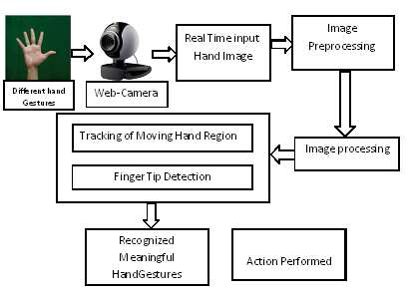
Flow chart of Gesture Recognition

Slide 15
Text to speech module : Text-to-Speech (TTS) refers to the ability of computers to read text aloud. A TTS Engine converts written text to a phonemic representation, then converts the phonemic representation to waveforms that can be output as sound. TTS engines with different languages, dialects and specialized vocabularies are available through third-party publishers.
Speech to text conversion : It decodes the voice command and performs the operation then shows the voice command as textual output in the terminal.
Speech recognition : It is also known as automatic speech recognition (ASR), computer speech recognition, or speech-to-text, is a capability which enables a program to process human speech into a written format.
The assistant continually asks the user for feedback and watches for new commands. Depending on the user's requirements, the receiving or listening time can be changed.
If the helper doesn't comprehend the instruction the first time, it will keep inquiring the user to pardon it.
This assistant may be set to talk in either a male or female voice, depending on the user's preferences.
A collection of interconnected modules makes up the Python Library. provides content packages that can be used many times across different applications. It simplify and makes programming useful for the editor. Packages like OpenCV, mediapipe, pyttsx3, and speech recognition have been utilised by us.

Slide 16
ARCHITECTURE DIAGRAM

Slide 17
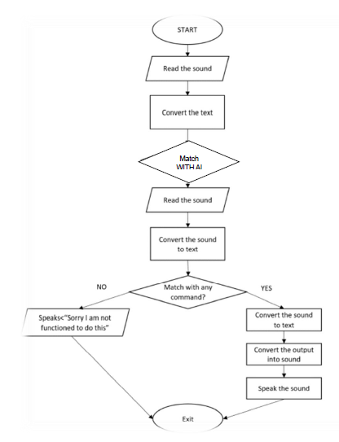
ARCHITECTURE OF VOICE ASSISTANT

Slide 18
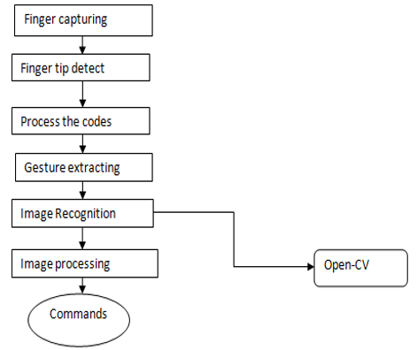
DATA FLOW DIAGRAM

Slide 19
ER- DIAGRAM
Profile
Login
Performs Actions
Name
Listen Voice
gives output
End User
M
Voice Assistant
Uses
1
1
Voice Command
Integrated
Gesture Command
1
Gesture Recognition
Hand Signs
Returns output
Performs Action

Slide 20
TESTING
UNIT TESTING
INTEGRATION TESTING
FUNCTIONAL TESTING
WHITE BOX TESTING
BLACK BOX TESTING

Slide 21
UNIT TESTING
Test Steps:
1.Construct an instance of the virtual mouse control system to begin the test.
2.Fake a series of hand motions that are well-known to the system.
3.Call the fictitious mouse control mechanism using imitation hand movements as input.
4.Confirm that the system responds to the mimicked input with the expected mouse movement commands.
Test Data:
- Five hand gestures were used in the test: a fist, an open palm, a point, a left swipe, and a right swipe.
- Provide commands that correspond to each intended mouse gesture:
- Fist: left-click
- Open palm: right-click
- Point: position the cursor where it is pointing
- Swipe left: move cursor left

Slide 22
INTEGRATION TESTING
Test Steps:
1. Establish a virtual mouse control system and a gesture recognition system instance.
2. Create a mock set of hand motions that the gesture detection system can identify. Send the virtual mouse control system the motions that were recognised.
3. Confirm that the virtual mouse control system responds to the recognised gestures by producing the anticipated mouse movement commands.
4. Repeat steps 2-4 for different situations and hand motions.
Test Data:
A set of 10 hand gestures: fist, open palm, point, swipe left, swipe right, pinch, double tap, swipe up, swipe down, and zoom Corresponding expected mouse movement commands for each gesture: Fist, left-click Open palm, right-click Point, move cursor to the pointed position Swipe left, move cursor left Swipe right, move cursor right Pinch, zoom in or out Double tap, double left-click Swipe up.

Slide 23
FUNCTIONAL TESTING
Test Steps:
1. Start the gesture recognition and virtual mouse systems as test steps.
2. To mimic real-world usage, make a variety of hand movements in front of the gesture detection system.
3. Watch the mouse movement that results on the computer screen.
4. Try out the virtual mouse system's following features:
Click left, then click right cursor motion Scrolling Zooming.
5. Try the ensuing situations:
Making hand movements at various rates, varying the distance at which hand gestures
are made, In front of the gesture recognition system using various hand sizes and shapes to make motions.

Slide 24
WHITE BOX TESTING
Test Steps:
1. To find the crucial elements and operations, examine the source code of the gesture recognition and virtual mouse systems.
2. List each crucial component's and function's input and output.
3. Create test cases that cover all potential input-output combinations, including edge cases and error circumstances, for each crucial component and function.
4. Run the test cases, then record the results for each input.
5. For each test case, compare the actual output to the intended output.
6. Look for any problems or anomalies in the actual output, and then look into the source code to determine what caused them.
7. Once all test cases pass, address the underlying issue and repeat steps 4-6.

Slide 25
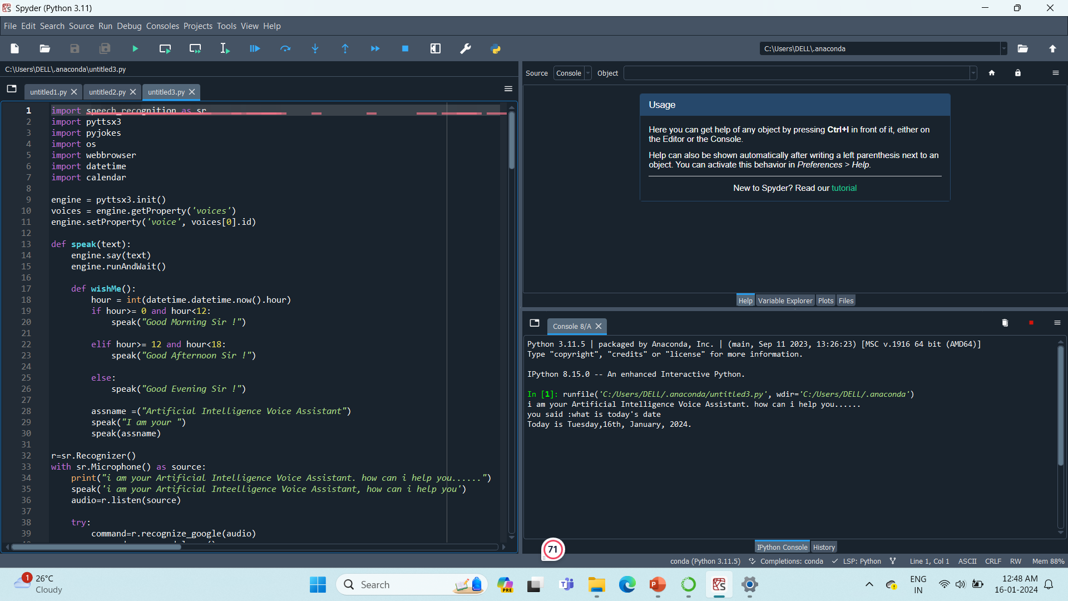
IMPLEMENTATION

Slide 26
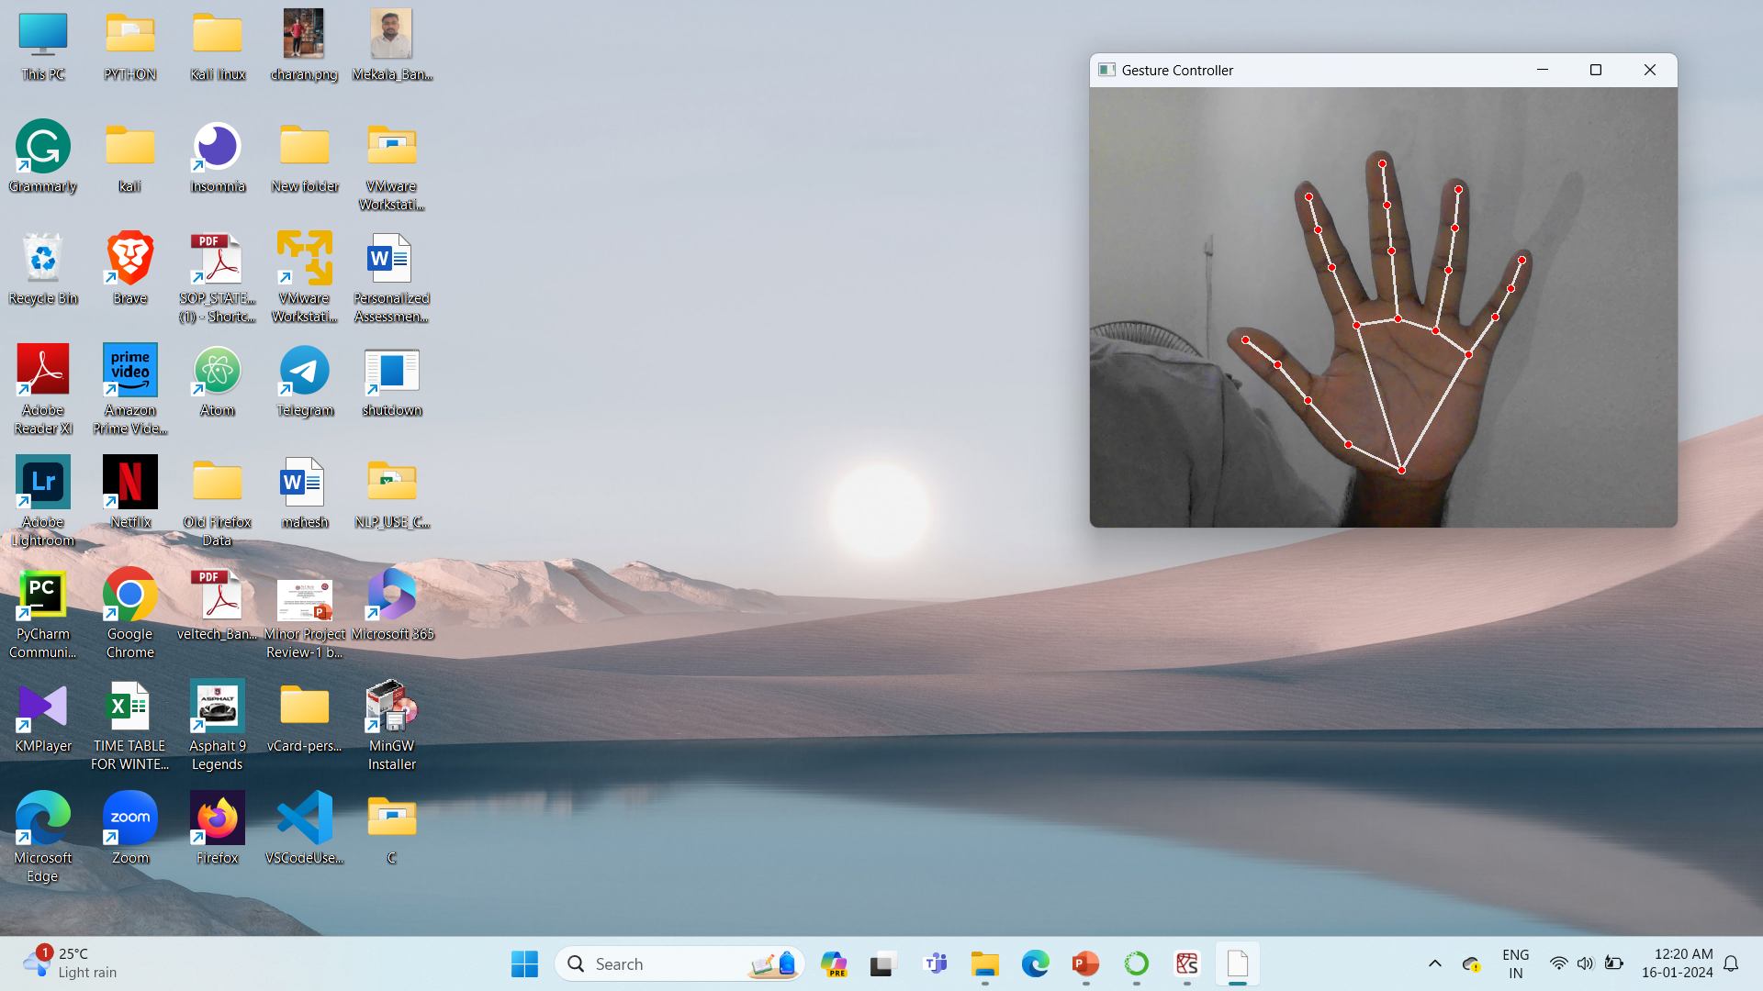
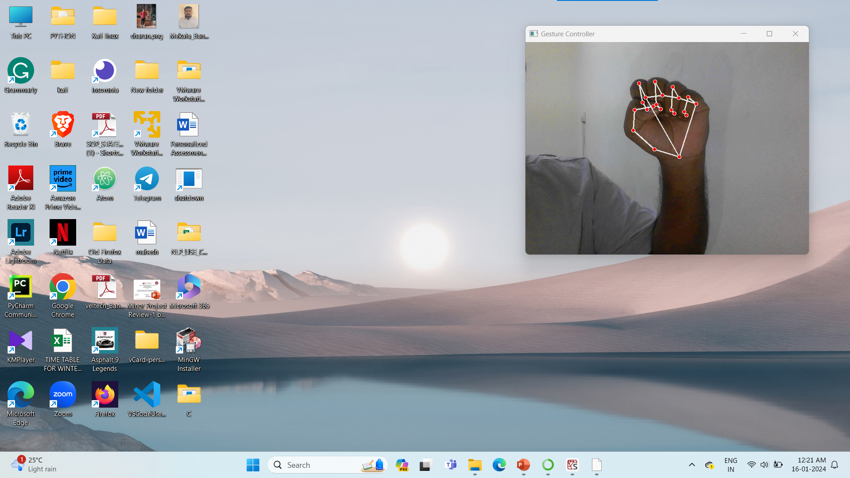
IMPLEMENTATION

Slide 27
CONCLUSION
The fundamental goal of the virtual mouse concept is to eliminate the necessity for a hardware mouse and, instead, utilize hand movements for controlling the mouse cursor on the screen. This is accomplished by processing frames to perform the required mouse operations based on detected fingers and hand tips. The suggested system can be implemented effortlessly using either a webcam or an embedded camera.
Individuals facing impairments will discover the voice-activated personal assistant as an exceptionally practical and time-saving solution in today's fast-paced lifestyles. When it comes to performing some of the tasks the user requests, this helper performs an excellent job. Moreover, this assistant can do a broad range of operations in response to a particular voice command, such as sending text messages to the user device, automating YouTube, and retrieving information from Google and Wikipedia. We have been able to automate multiple services with a unified command thanks to the voice assistant. This tool makes it easier for users to do the bulk of their tasks, such as internet searches. Our aim is for this programme to be completely capable of replacing the need for human server admins. As this system is made on Anaconda community, so any adjustments may be made immediately.

Slide 28
WEB REFERENCES LINK
https://developers.google.com/mediapipe/solutions/vision/gesture_recognizer/python
https://www.youtube.com/watch?v=a99p_fAr6e4&list=PL0FM467k5KSyt5o3ro2fyQGt-6zRkHXRv
https://www.youtube.com/watch?v=ob0p7G2QoHA

Slide 29

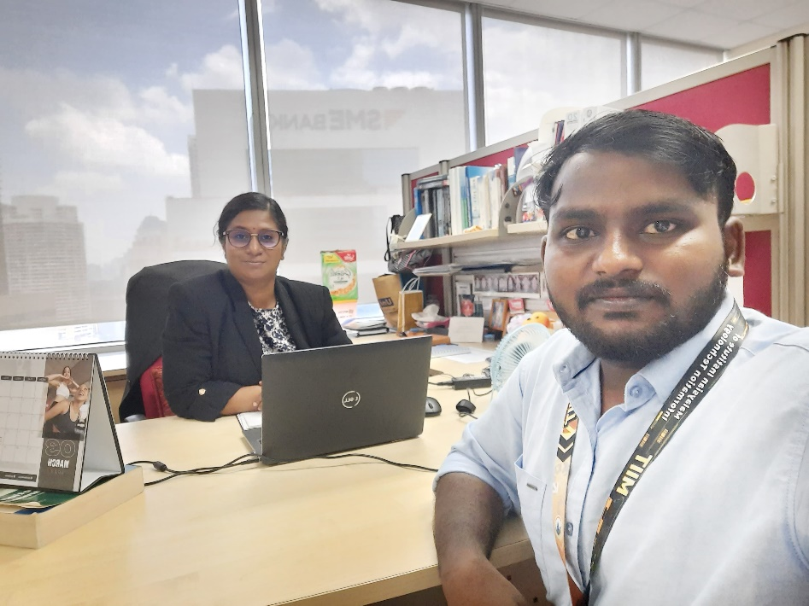
INCLUDE YOUR 2 PHOTOS OF YOUR INDUSTRY WORKING ENVIRONMENT

Slide 30
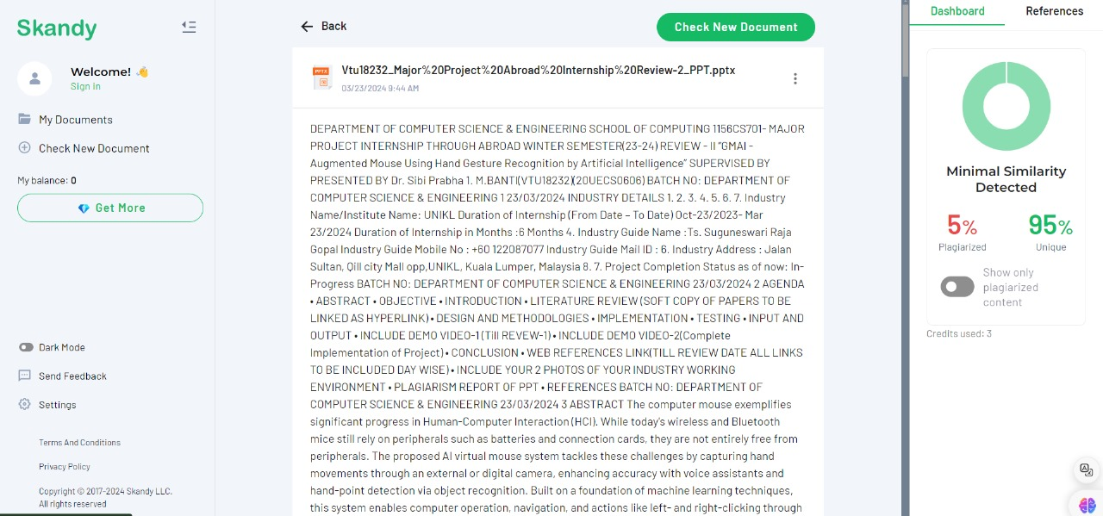
PLAGIARISM REPORT OF PPT

Slide 31
References
[1] Kirti Aggarwal, Anuja Arora. ”To Control the PC with Hand Gesture Recognition instead of traditional physical mouse using Computer Vision Technique”.In proceeding of the 2022 9th International Conference on Computing for Sustainable Global Development (INDIACom). IEEE.
[2] M. Ranawat, M. Rajadhyaksha, N. Lakhani & R. Shankarmani, 2022 "Hand Gesture Recognition Based Virtual Mouse Events” 2nd International Conference for Emerging Technology (INCET) IEEE 2021
[3] Dudhapachare, R., Vaidya, N., Awatade, M., Kapgate, M., Kakde, P., & Nakhate, R. (2021). Voice Guided, Gesture Controlled Virtual Mouse. IEEE International Conference on Power Electronics & IoT Applications in Renewable Energy and its Control (PARC), 1-6. doi: 10.1109/PARC52418.2022.9726654
[4] Vinay, K. P. (2021). Cursor control using hand gestures. International Journal of Critical Accounting, 8(1/2), 98-105. doi: 10.1504/IJCA.2016.076926
[5] Thomas, L., Chaithanya, C., Wilson, N., & Abhilash, S. S. (2020). Virtual mouse using hand gesture. International Research Journal of Engineering and Technology (IRJET), 5(4), 1-5.

Slide 32
[5] Boruah, P., Das, S., & Bhattacharyya, D. (2019). Hand gesture recognition: A review. International Journal of Computer Applications, 182(45), 1-7. doi: 10.5120/ijca2019919425
[6] Tran, D. S., Ho, N. H., Yang, H. J., Kim, S. H., & Lee, G. S. (2021). Real-time virtual mouse system using RGB-D images and fingertip detection. Multimedia Tools and Applications, 80(7), 10473-10490. doi: 10.1007/s11042-020-10287-6
[7] Katona, J. (2021). A review of human-computer interaction and virtual reality research fields in cognitive Info Communications. Applied Sciences, 11(6), 2646. doi: 10.3390/app11062646
[8] Koushik Roy and Md. Akiful Hoque Akif, ‘Real Time Hand Gesture Based User Friendly Human Computer Interaction System”. In proceeding of the 2022 International Conference on Innovations in Science, Engineering and Technology (ICISET). IEEE.

Slide 33
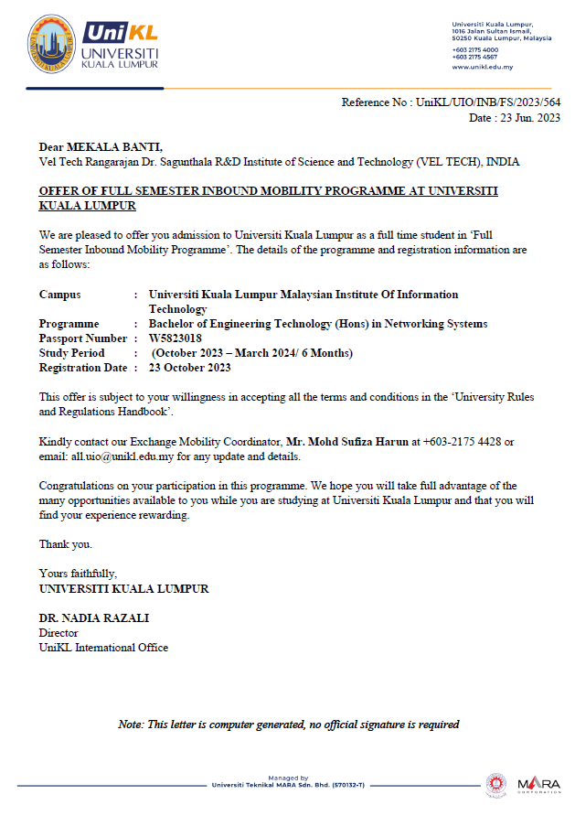
OFFER LETTER SOFT COPY

Slide 34
THANK YOU

